Slide 1

PSG INSTITUTE OF TECHNOLOGY AND APPLIED RESEARCH DEPARTMENT OF ECE
EC8811 - PROJECT WORK - SECOND REVIEW
Brain Tumor Detection and Classification using Deep Learning
GUIDE:
Dr. P. Vetrivelan, M.E., Ph.D., Associate Professor, Department of ECE
MEMBERS:
Keerthana Vasan S - 715520106028
Nithyan R - 715520106033
Sanjay K - 715520106040
Shreedhar G D - 715520106044

Slide 2
PROBLEM STATEMENT
Diagnosing a brain tumor takes a long time and relies heavily on the radiologist’s abilities and experience.
The amount of data that must be handled has increased dramatically as the number of patients has increased, making old procedures both costly and ineffective.
The challenge is to create a new procedure which takes less time and is cost effective.
2

Slide 3
OBJECTIVE
Deep Learning (DL) approaches have recently been popular in developing automated systems capable of accurately diagnosing or segmenting brain tumors in less time.
DL enables a pre-trained Convolutional Neural Network (CNN) model for medical images, specifically for classifying brain cancers.
The proposed work is to take all the final output of the pre-tained networks and find their accuracy and effectiveness.
Thus, the best model with highest accuracy to detect and classify the brain tumors can be used.
3

Slide 4
LITERATURE SURVEY
S.NO | TITLE OF THE PAPER | JOURNAL | DATASETS | Author(s) | INFERENCE
[1] | Brain Tumor Detection and Classification Using Deep Learning and Sine-Cosine Fitness Grey Wolf Optimization | Bioengineering, MDPI (December 2022) | BRaTS 2021 Task 1 dataset. | ZainEldin, H.; Gamel, S.A.; El-Kenawy | The model employs a pre-trained CNN architecture. Hyperparameters are optimized using ADSCFGWO, which combines the strengths of both sine cosine and grey wolf algorithms.
[2] | Accurate brain tumor detection using deep convolutional neural network | Computational and Structural Biotechnology Journal 20, Elsevier (August 2022) | Harvard Medical dataset | Md. Saikat Islam Khan, Anichur Rahman, Tanoy Debnath | The proposed approach combines a 23-layer CNN with transfer learning using the VGG16 architecture to address overfitting in limited data scenarios.
4

Slide 5
LITERATURE SURVEY
S.NO | TITLE OF THE PAPER | JOURNAL | DATASETS | Author(s) | INFERENCE
[3] | A Hybrid CNN-SVM Threshold Segmentation Approach for Tumor Detection and Classification of MRI Brain Images. | IRBM Elsevier (August 2022) | BRaTS 2021 Task 1 dataset. | M.O. Khairandish, M. Sharma, V. Jain, J.M. Chatterjee, N.Z. Jhanjhi | The proposed hybrid model combined CNN and support vector machine (SVM) in terms of classification of benign and malignant tumors
[4] | Automated Categorization of Brain Tumor from MRI Using CNN features and SVM | Journal of Ambient Intelligence and Humanized Computing (OCT 2020) | Figshare | Deepak, S., Ameer, P.M | This model uses the combination of CNN and SVM model to classify 3 types of tumors - meningioma, glioma, and pituitiary
5

Slide 6
LITERATURE SURVEY
S.NO | TITLE OF THE PAPER | JOURNAL | DATASETS | Author(s) | INFERENCE
[5] | MRI brain tumor medical images analysis using deep learning techniques: a systematic review | Health and Technology, SpringerLink (January 2021) | BRATS Datasets | Al-Galal, S.A.Y., Alshaikhli, I.F.T. & Abdulrazzaq | A comprehensive overview of the state-of-the-art processing of brain medical images using deep neural networks is detailed here (DL, DNN).
6

Slide 7
Datasets
Rhythms | No. of samples
Giloma Tumor | 928
Meningioma tumor | 939
No tumor | 502
Pituitary tumor | 903
Source : National University of Singapore
7

Slide 8
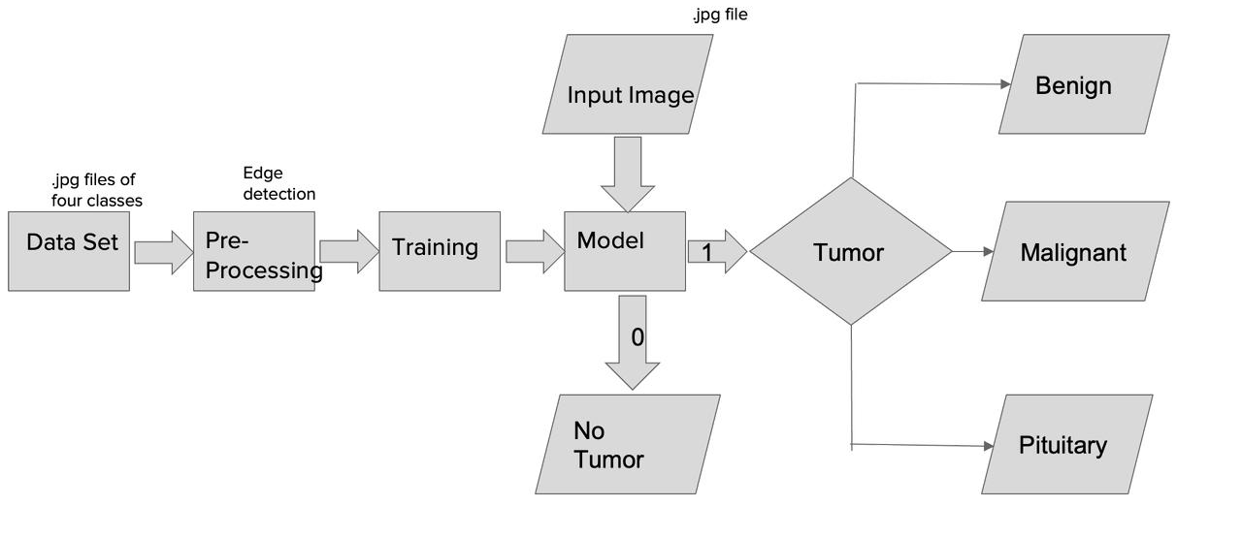
BLOCK DIAGRAM
8

Slide 9
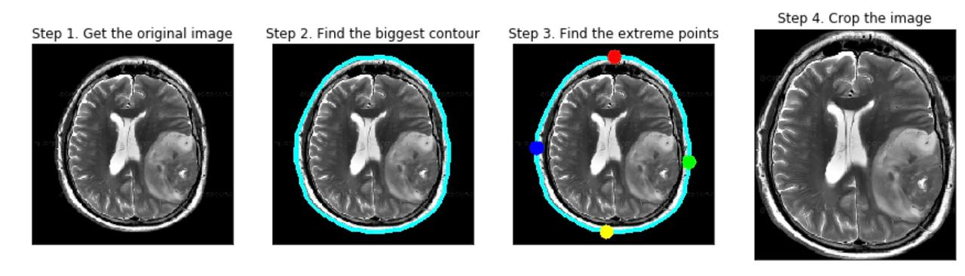
PREPROCESSING
9

Slide 10
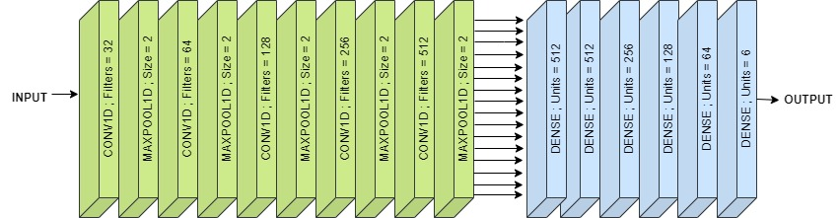
CNN ALGORITHM
10

Slide 11
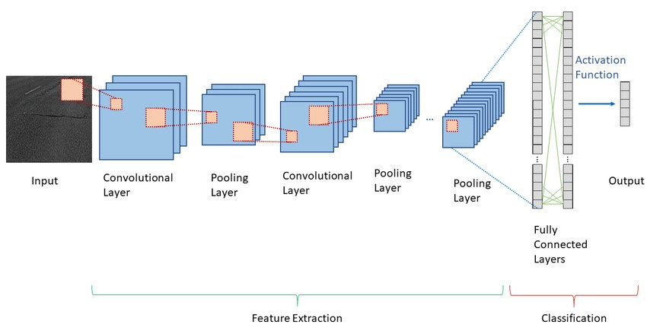
CNN ALGORITHM

Slide 12
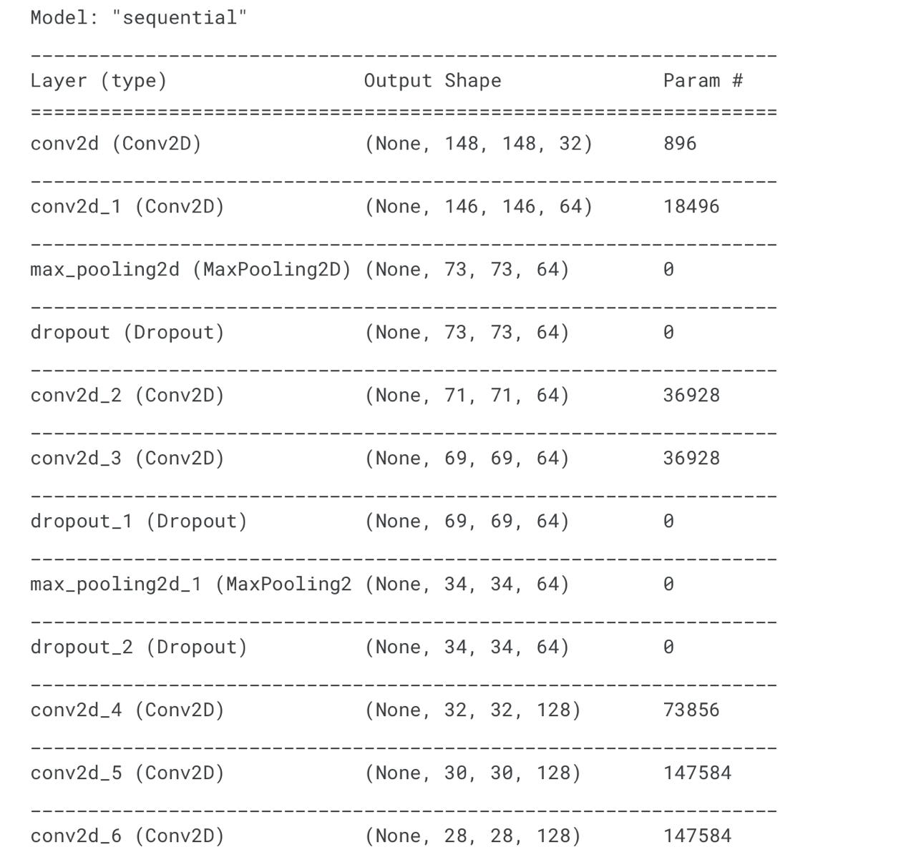
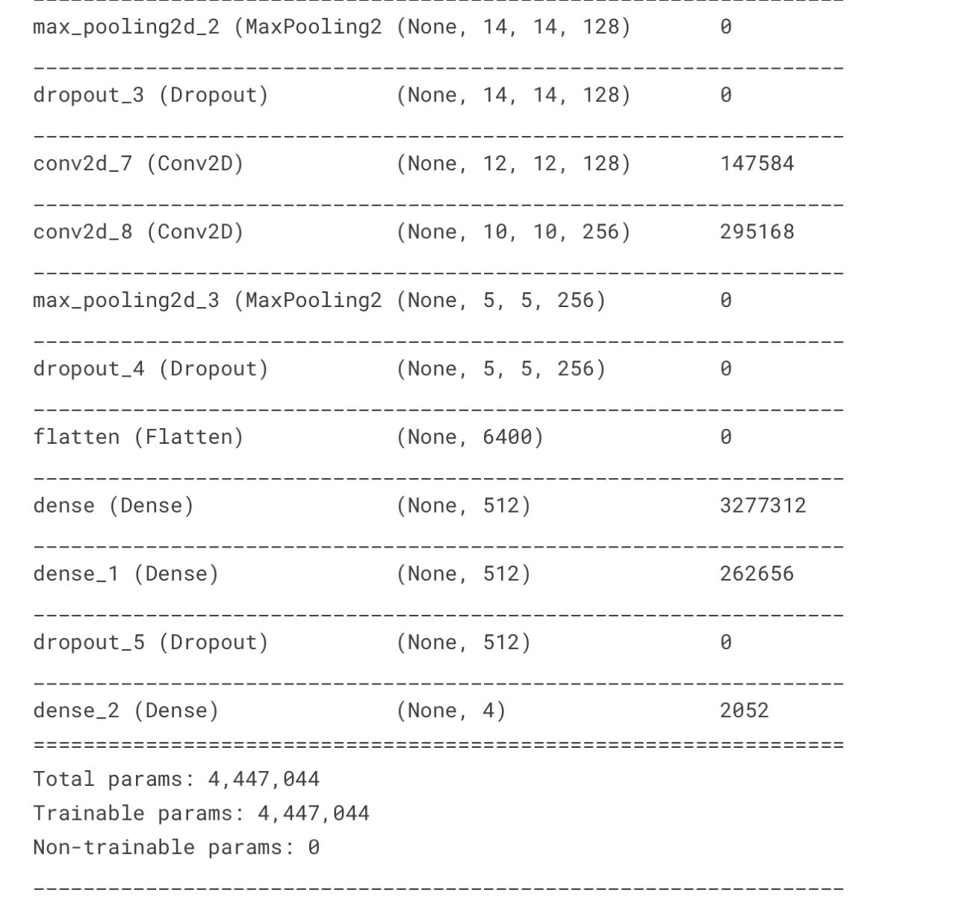
CNN MODEL
12

Slide 13
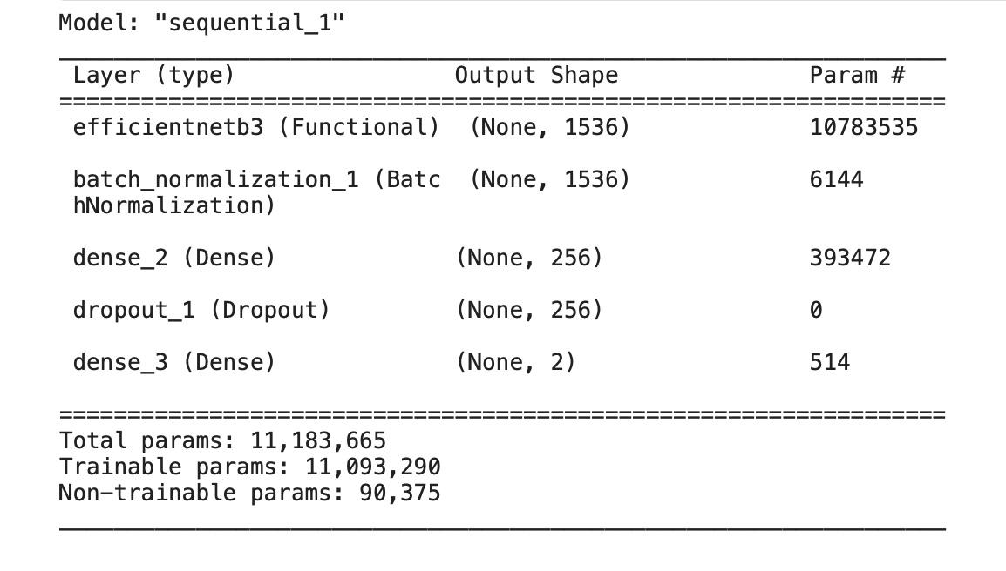
EfficientnetB3 MODEL
13

Slide 14
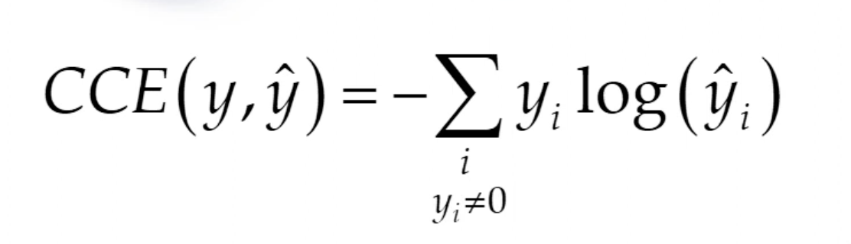
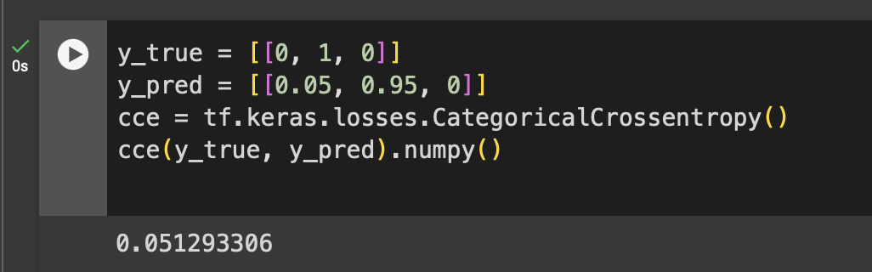
Categorical cross entropy for Performance computation
Formula:
Example:
14
14

Slide 15
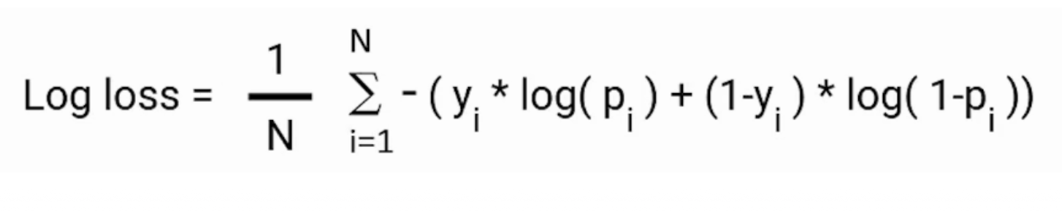
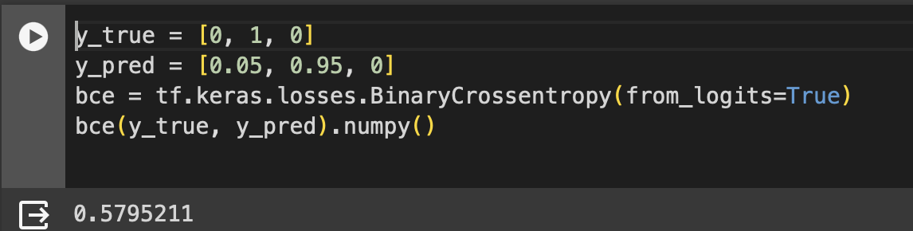
Binary cross entropy for Performance computation
Formula:
Example:
15
15

Slide 16
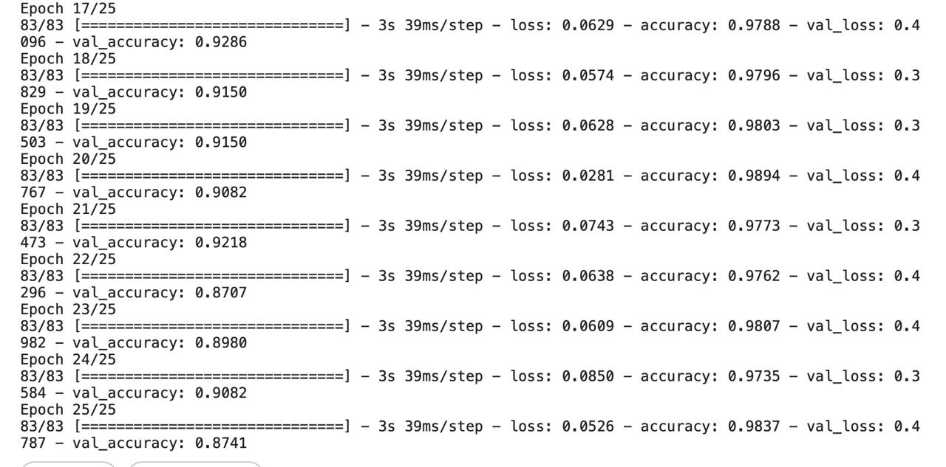
CNN MODEL RESULTS
16

Slide 17
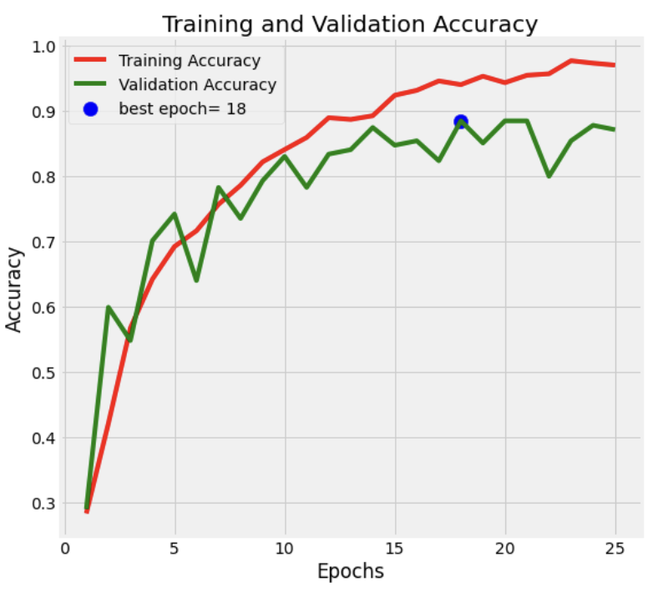
CNN MODEL RESULTS
17
17

Slide 18
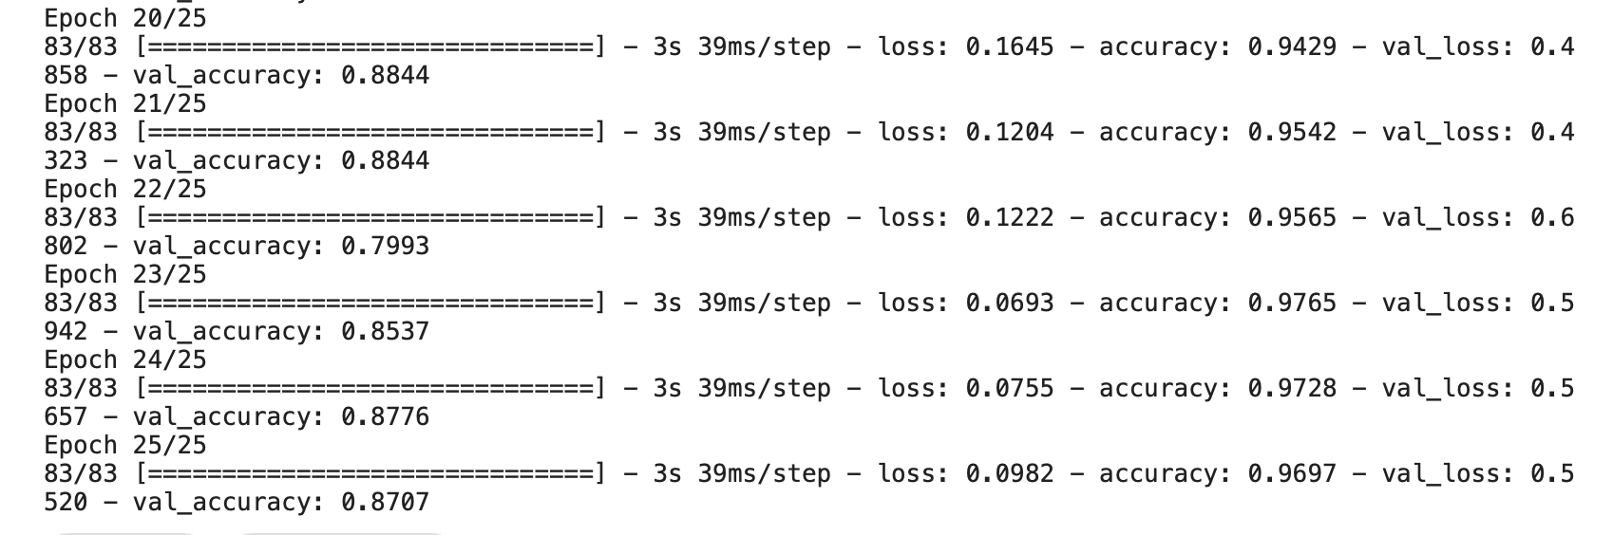

EfficientnetB3 MODEL RESULTS
18

Slide 19
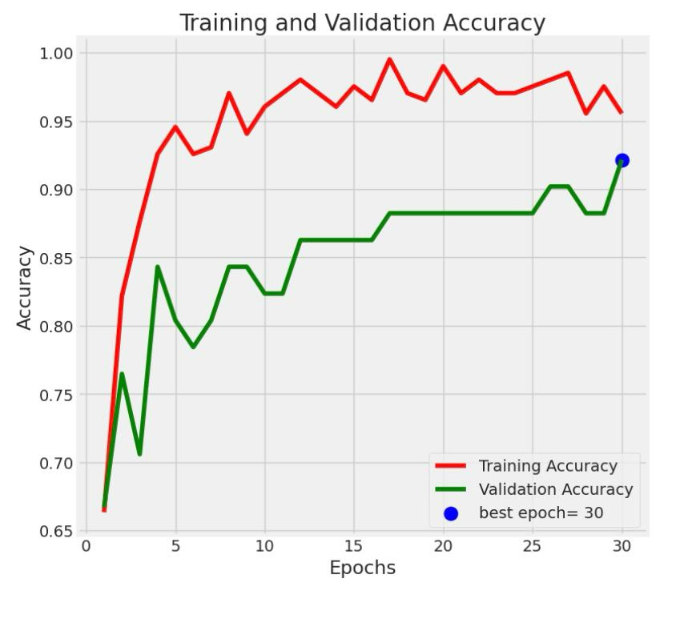
EfficientnetB3 MODEL RESULTS

Slide 20
Future works
Increase number of tumor types that can be detected.
Provide feature to detect other medical conditions in MRI.
Complete the system by develop model for 3D images.
Provide feature to mark the affected area in MRI.
20
20

Slide 21
TIMELINE
FEB 2024
MAR 2024
APR 2024
APR 2024
Implementation of different algorithms and finding their accuracy
Validation and Performance analysis of the best model
Designing the model to classify the brain tumors.
Pre-processing

Slide 22
REFERENCES
ZainEldin, H.; Gamel, S.A.; El-Kenawy, E.-S.M.; Alharbi, A.H.; Khafaga, D.S.; Ibrahim, A.; Talaat, F.M. Brain Tumor Detection and Classification Using Deep Learning and Sine-Cosine Fitness Grey Wolf Optimization. Bioengineering 2023, 10, 18. https://doi.org/10.3390/ bioengineering10010018
Md. Saikat Islam Khan, Anichur Rahman, Tanoy Debnath, Md. Razaul Karim, Mostofa Kamal Nasir, Shahab S. Band, Amir Mosavi, Iman Dehzangi, Accurate brain tumor detection using deep convolutional neural network, Computational and StructuralBiotechnologyJournal,Volume20,2022.https://doi.org/10.1016/j.csbj.2022.08.039.
M.O. Khairandish, M. Sharma, V. Jain, J.M. Chatterjee, N.Z. Jhanjhi,A Hybrid CNN-SVM Threshold Segmentation Approach for Tumor Detection and Classification of MRI Brain Images,RBM,Volume 43, Issue 4,2022,https://doi.org/10.1016/j.irbm.2021.06.003.
Deepak, S., Ameer, P.M. Automated Categorization of Brain Tumor from MRI Using CNN features and SVM. J Ambient Intell Human Comput , 8357–8369 (2021). https://doi.org/10.1007/s12652-020-02568-w
Al-Galal, S.A.Y., Alshaikhli, I.F.T. & Abdulrazzaq, M. MRI brain tumor medical images analysis using deep learning techniques: a systematic review. Health Technol. 267–282 (2021). https://doi.org/10.1007/
22

Slide 23
THANK YOU

